Slide 1

USAF Installations (A-C)

Slide 2
USAF Installations (A-C)

Slide 3
USAF Installations (A-D)
Increase in Case and Death rates over last 7 days

Slide 4
USAF Installations (E-L)

Slide 5
USAF Installations (M-W)

Slide 6
USAF Core Missions (1 of 2)

Slide 7
USAF Core Missions (2 of 2)

Slide 8
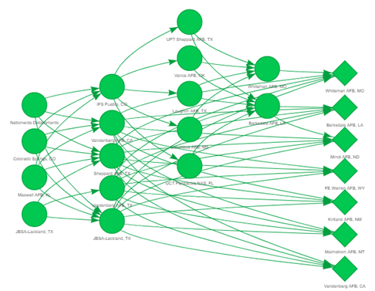
Human Supply Chain Pipeline
Nuclear Surety Training Pipeline
Accession
Tech 1
Tech 2
Tech 3
Operational

